Slide 1
Reception at Richmond Avenue Primary School
Reception and Early Years at Richmond

Slide 2
EYFS 2021 Curriculum
This year there have been changes made to the Early Years curriculum by the government.
As a school we have decided to use a combination of curriculum documents to create our curriculum for the children.
- Development Matters & Birth to five matters.
There are 7 areas of the curriculum.
PSED, Communication and Language, Maths, Literacy, Physical Development, EAD, Understanding the World.
These areas have remained the same from the previous curriculum, however it is the 17 areas within them that have altered.

Slide 3
Personal, social and emotion development
Building Relationships-
Work and play cooperatively and take turns with others.
Form positive attachments to adults and friendships with peers.
Show sensitivity to their own and to others’ needs.
Managing Self-
Be confident to try new activities, show independence, resilience and perseverance.
Know right from wrong and try to behave accordingly.
Manage their own basic hygiene and personal needs, including dressing, going to the toilet and understanding the importance of healthy food choices.
Self-Regulation-
Show an understanding of their own feelings and those of others.
Set and work towards simple goals, being able to wait for what they want and control their immediate impulses when appropriate.
Give focused attention to what the teacher says, responding appropriately even when engaged in activity, and show an ability to follow instructions involving several ideas or actions.

Slide 4
Communication and Language
Listening, attention and understanding-
Listen attentively and respond to what they hear with relevant questions, comments and actions.
Make comments about what they have heard and ask questions to clarify their understanding.
Hold conversation when engaged in back-and forth exchanges with their teacher and peers.
Speaking-
Participate in small group, class and one-to-one discussions, offering their own ideas.
Offer explanations for why things might happen, making use of recently introduced vocabulary.
Express their ideas and feelings about their experiences using full sentences, including use of past, present and future tenses and making use of conjunctions.

Slide 5
Physical Development
Gross Motor Skills
Negotiate space and obstacles safely, with consideration for themselves and others.
Demonstrate strength, balance and coordination when playing.
Move energetically, such as running, jumping, dancing, hopping, skipping and climbing.
Fine Motor Skills
Hold a pencil effectively– using the tripod grip in almost all cases.
Use a range of small tools, including scissors, paintbrushes and cutlery.
Begin to show accuracy and care when drawing.
Health-
Manage their own basic hygiene and personal needs, including dressing, going to the toilet and understanding the importance of healthy food choices.

Slide 6
Understanding the world
People, culture and communities-
Describe their immediate environment.
Know some similarities and differences between different religious and cultural communities in this country.
Explain some similarities and differences between life in this country and life in other countries.
The Natural World-
Explore the natural world around them, making observations and drawing pictures of animals and plants.
Know some similarities and differences between the natural world around them and contrasting environments.
Understand some important processes and changes in the natural world around them, including the seasons and changing states of matter.]
Past and Present-
Talk about the lives of the people around them and their roles in society.
Know some similarities and differences between things in the past and now.
Understand the past through settings, characters and events encountered in books read in class and storytelling.

Slide 7
Expressive art and design
Creating with materials-
Safely use and explore a variety of materials, tools and techniques, experimenting with colour, design, texture, form and function.
Share their creations, explaining the process they have used.
Make use of props and materials when role playing characters in narratives and stories.
Being imaginative and expressive-
Invent, adapt and recount narratives and stories with peers and their teacher.
Sing a range of well-known nursery rhymes and songs.
Perform songs, rhymes, poems and stories with others, and try to move in time with music.

Slide 8
How do we teach these?
Adults modelling PSED.
Group activities to encourage sharing and taking turns.
Weekly PE lessons.
Weekly music lessons.
Circle time activities.
Art activities through our topics
Ensure our topics involve learning about different aspects of the world and different cultures.

Slide 9
Maths
Number-
Have a deep understanding of number to 10, including the composition of each number.
Subitise (recognise quantities without counting) up to 5.
Automatically recall (without reference to rhymes, counting or other aids) number bonds up to 5 (including subtraction facts) and some number bonds to 10, including double facts.
Numerical patterns-
Verbally count beyond 20, recognising the pattern of the counting system.
Compare quantities up to 10 in different contexts, recognising when one quantity is greater than, less than or the same as the other quantity.
Explore and represent patterns within numbers up to 10, including evens and odds, double facts and how quantities can be distributed equally.

Slide 10
How we teach this
Two weekly adult-led activities.
Four carpet inputs based around the new concepts.
Often be documented on Tapestry.
Initially in Autumn term we focus on the children’s knowledge of number and the concepts within eg one more, one less, addition, subtraction.
Encourage children to use a variety of maths skills within their play.
Learning to form their numbers correctly.

Slide 11
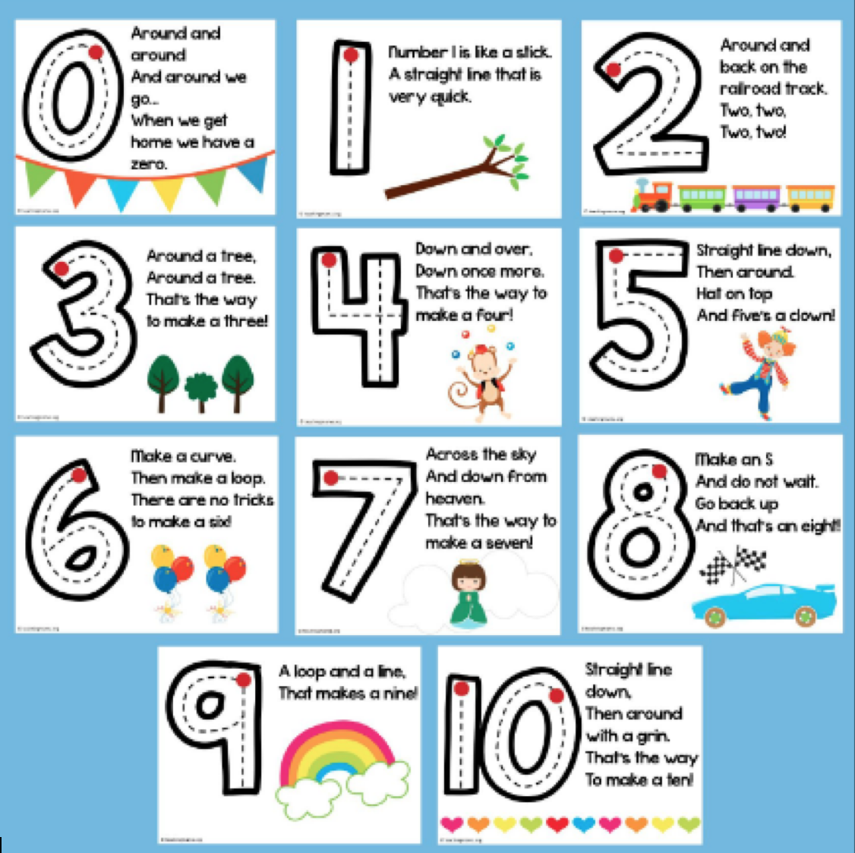

Slide 12
Literacy
Reading comprehension-
Demonstrate understanding of what has been read to them by retelling stories and narratives using their own words .
Anticipate key events in stories.
Use and understand recently introduced vocabulary during discussions about stories, non-fiction, rhymes and poems and during role play.
Word reading-
Say a sound for each letter in the alphabet and at least 10 digraphs.
Read words consistent with their phonic knowledge by sound-blending.
Read aloud simple sentences and books that are consistent with their phonic knowledge, including some common exception words.
Writing-
Write recognisable letters, most of which are correctly formed.
Spell words by identifying sounds in them and representing the sounds with a letter or letters.
Write simple phrases and sentences that can be read by others.

Slide 13
How this is taught…
Daily 30 minute phonic lessons.
Following Richmond phonic programme (combination of current phonic programmes).
Weekly Literacy lesson based around the topic that consolidates the learning in phonics.
Reading at home with an adult is important for your child.
Pink, red, yellow, blue, green, orange, turquoise, purple, gold, white, lime, brown, grey, dark-blue, dark-red and free reader (for Reception children the expectation is for them to be on red or yellow books by the end of the school year. We will continue to extend the children past yellow if they are ready).
Letter formation handout to help you when working with your child to ensure continuity.
Pronounciation of the sounds. Please see link on the website, to look at how to pronounce the sounds. RWI Set 1 Sounds Pronunciation Guide - Bing video

Slide 14
Phonics terminology that the children may use…
Digraph- To letters that together make one sound eg ay in play.
Tri-graph- Three letters together that make one sound eg igh in fight.
Split-digraph- Two letter that make one sound with a letter in between eg a-e in make.
Segment- To break down a word into individual sounds to read or write it.
Blend- To say the individual sounds quickly together to hear/read the whole word.

Slide 15
Any questions?

