Slide 1
Microsoft Teams
How to access and work within Teams

Slide 2
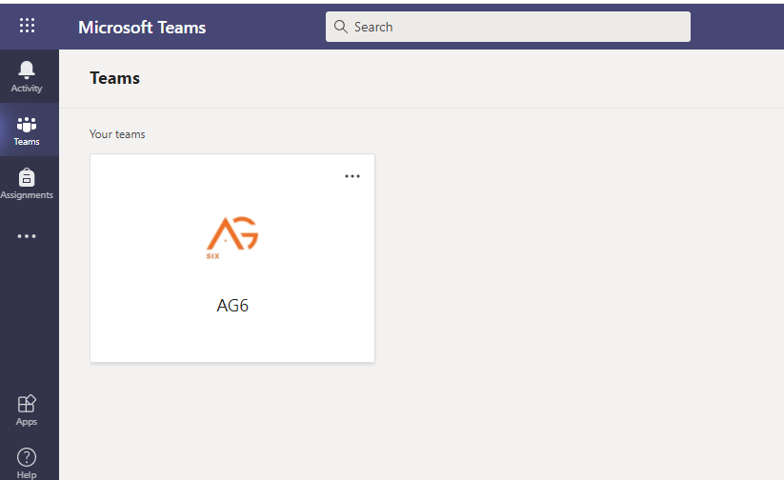
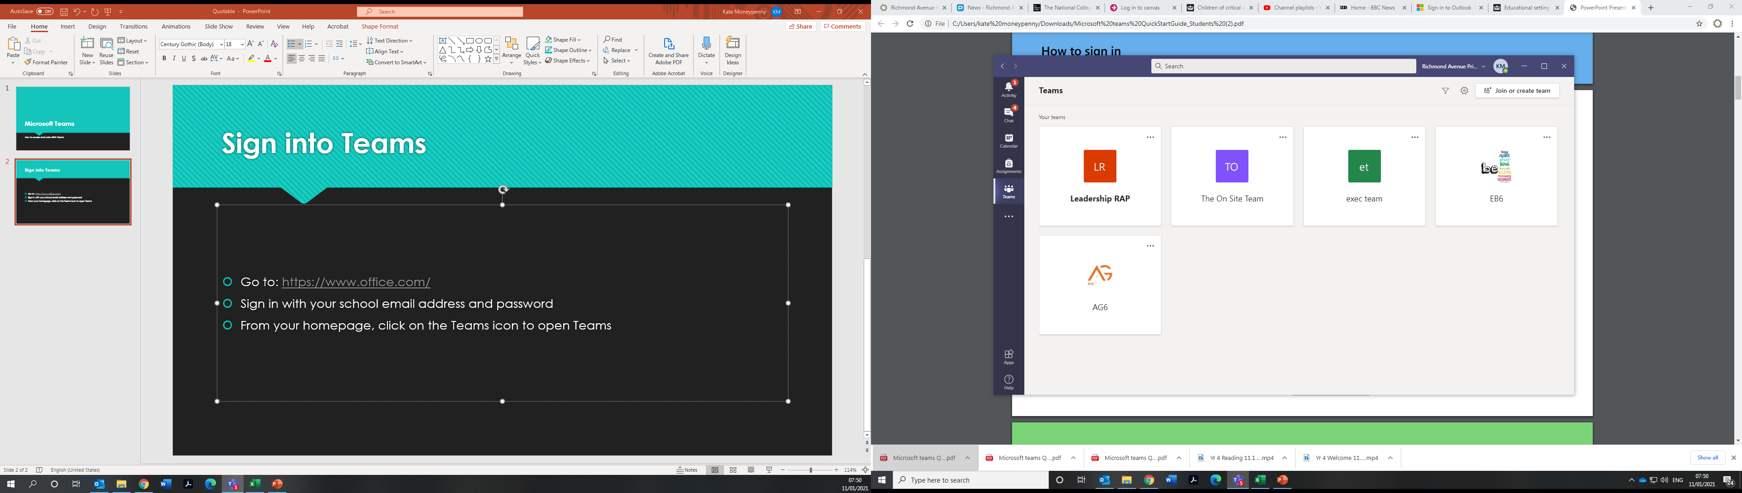
Getting Online
Teams can be used on a range of devices including:
  Laptops
  PC’s
  Tablets
  Mobile Phones
  Playstation
  XBox

Slide 3
Sign into Teams
Go to: https://www.office.com/
Sign in with your school email address and password
From your homepage, click on the Teams icon to open Teams
In Teams, you can then click on Teams on the left hand side and it will show you your year group to enter

Slide 4
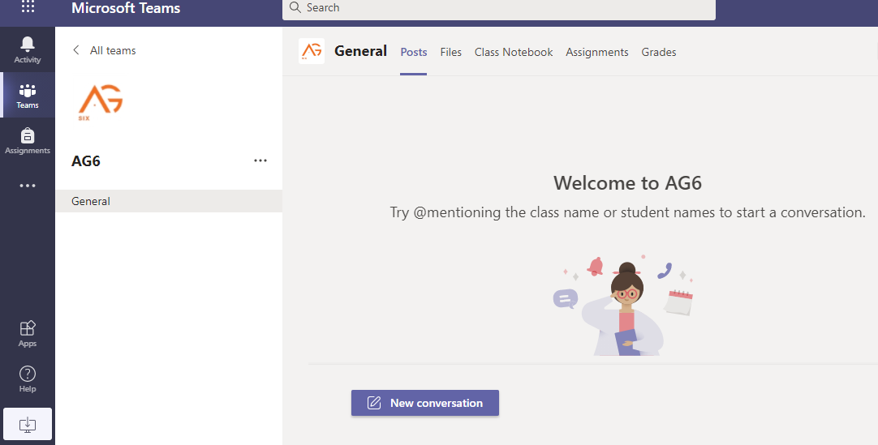
Your Online Class
Every year group has a main discussion area the ‘General’ Channel
There are also tabs across the top with ‘Posts’ ‘Files’ ‘Notebook’ and ‘Assignments’
Each of these areas will have information in relevant to your lessons and learning

Slide 5
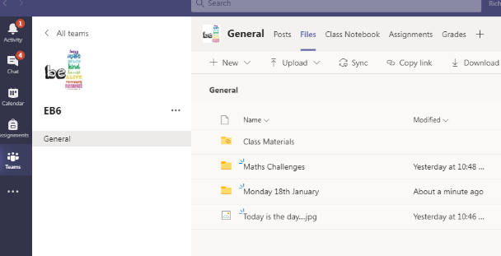
Files
Look here each morning for your work for the day…
The daily lessons document (previously emailed) will be in this file each morning…
Click to open the document and then click each link to watch the videos for each lesson

Slide 6
Files
In the Files Tab, your teacher will add resources and links to your lesson
There will be different folders labelled for the subject / activity beyond the daily files e.g. additional Maths challenges

Slide 7
Notifications
If you click ‘Activity’ on the left side of the page, you will see all the latest information and updates shared from your teacher
This will make sure you don’t miss any work / lessons

Slide 8
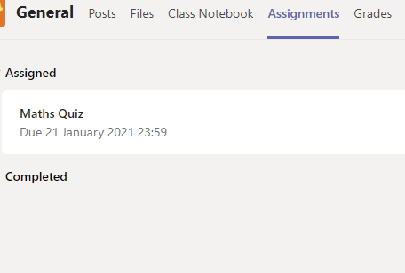
Assignments
In this section, teachers will set specific tasks for the children to complete
You just have to click on the task to follow the instructions set and then complete it
Teachers will also be able to give feedback on the work submitted

Slide 9

Handing in Work
Select the Assignments Tab
To view the assignment (work) and turning in work select the specific task
Attach any documents by clicking ‘+ Add Work’

Slide 10
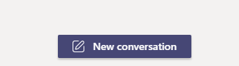
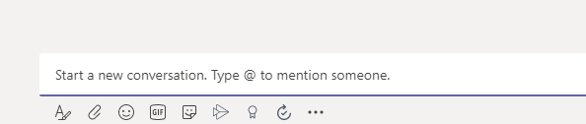
Help with work…
If you need help with any work / tasks, go to the ‘Posts’ section in your team
Then click on the ‘New Conversation’ icon
You can now type a message to your teacher and they can respond to you in the same section

